Slide 1
Footbased Activity Recognition midterm presentation
Seminar: Interactive Analytics
Supervisor: Erik Pescara
Group members: Alphan Yilmaz, Alexey Nevezhin, Anastasia Kryzhanovskaya, Anna Sinitsyna

Slide 2
Table of contents
Goal of our project
Progress
Movements
Hardware scheme
Sensor data output
Next steps

Slide 3
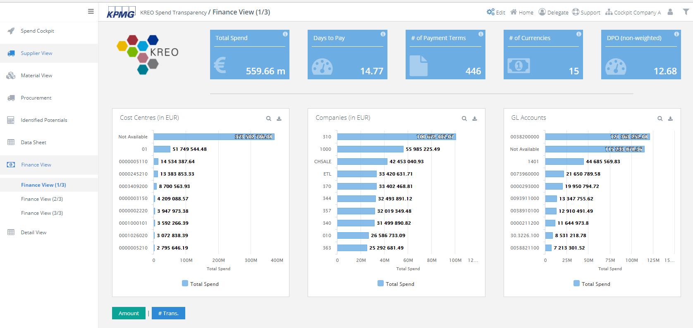
Goal
Design a foot-based movement recognition system
Controls can be mapped to interact with KPMG Dashboards and other applications (presentations, software development and others)
We focus on usability and reliability in everyday use

Slide 4
Progress
Brainstorm possible applications of our recognition system
Come up with user-friendly foot movements
Interface with provided sensors (Gyroscope, Accelerometer, Magnetometer)
Sample and visualize sensor data
Use machine learning on the data samples to differentiate between foot movements
Implement a graphical user interface (GUI)
Finish the documentation and create the final presentation

Slide 5
Possible applications
The foot sensor can be used as an input device, similar to the use of a mouse or keyboard
Individual control binding enables a highly personalized use
Frees the hands
Use the sensor as a second mouse, which eliminates the need to take the hands from the keyboard

Slide 6
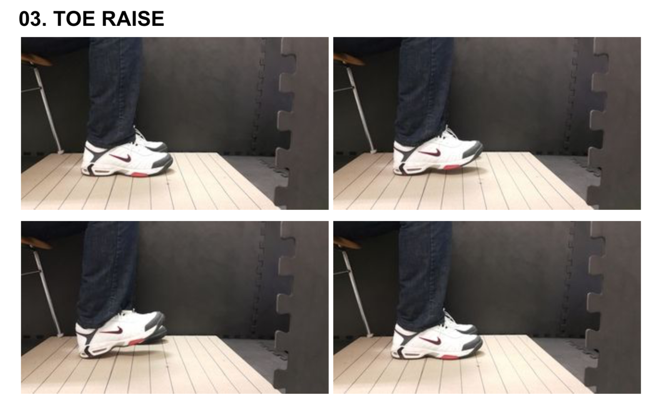
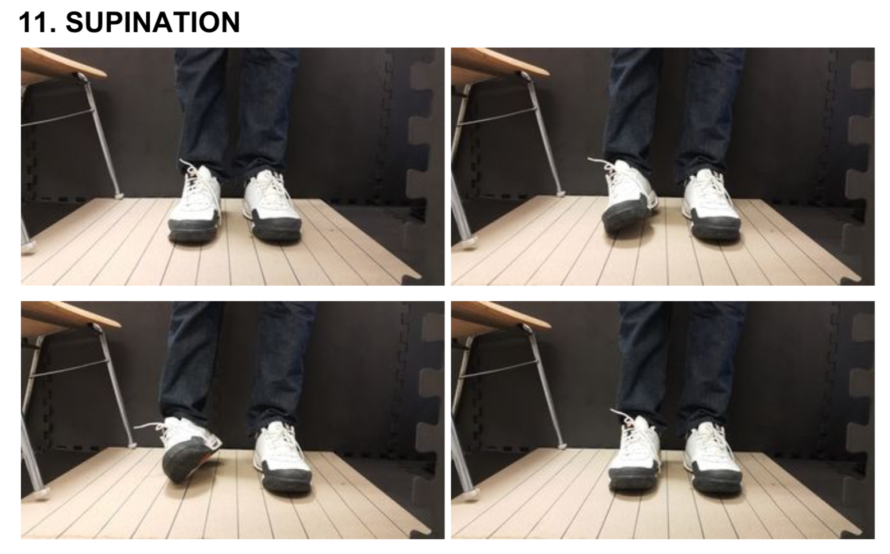
Movements
Movements should be easy to use in an everyday office environment
Planned movements (excerpt):
Toe and heel raise
One foot hover
Toe tap
Left and right side supination
Slides
Toe and heel rotation

Slide 7
Movements
Movements should be easy to use in an everyday office environment
Planned movements and mapped actions (excerpt):
Toe and heel raise → zoom in or out on the dasboard
One foot hover → end current application (Alt + F4)
Toe tap → scrolling
Left and right side supination → scrolling
Slides → scrolling up or down
Toe and heel rotation → swipe to next or previous dashboard

Slide 8
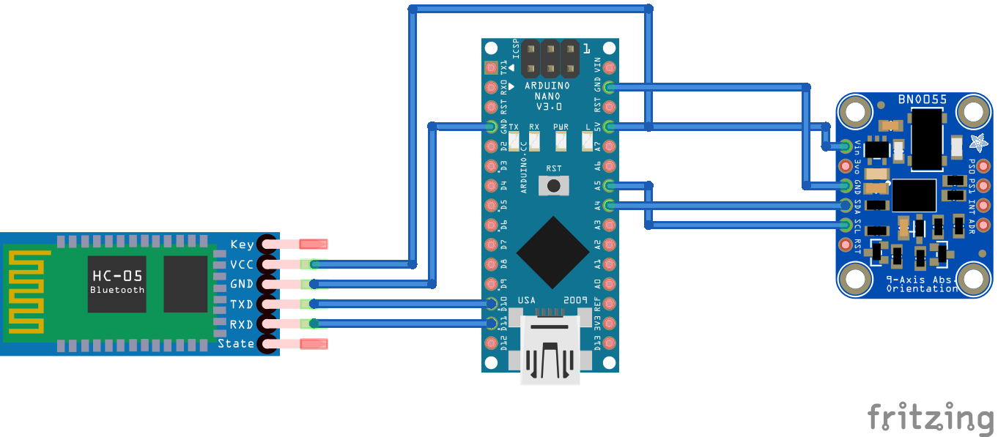
Hardware scheme
Our Hardware consist of three components (left to right):
Bluetooth module, Arduino and the sensor module

Slide 9
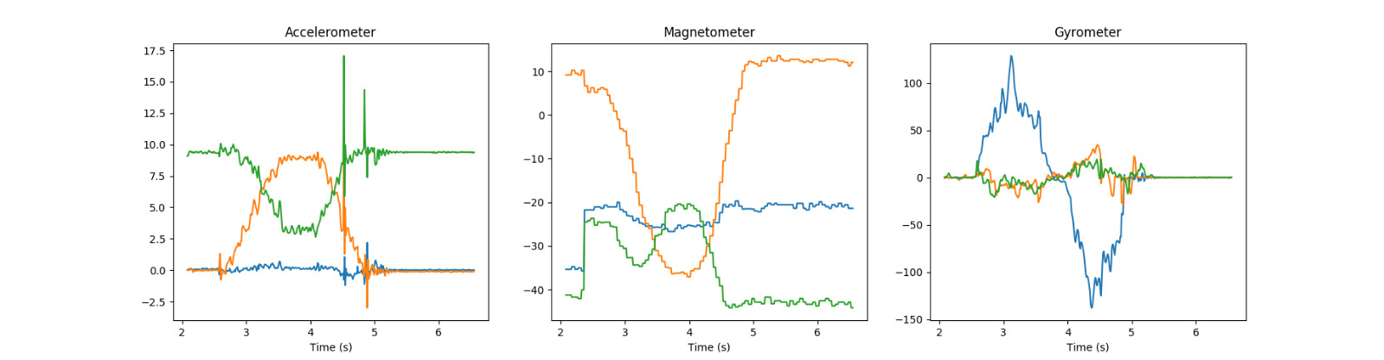
Sensor data output
This is the data we receive from out sensor for the movement „suspination“
In the future the system can differentiate between the movements based on the data alone

Slide 10
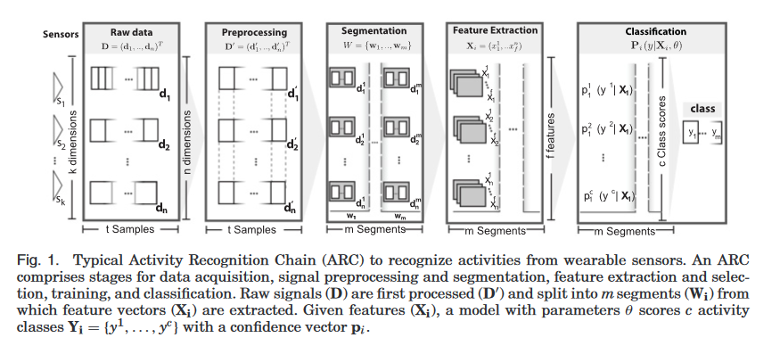
Next Steps
Finish implementing the (machine learning) pipeline
Implement a user interface
Finish the documentation and create the final presentation

Slide 11
Dashboard

